Slide 1



Mid Calder Primary School
Primary 7 – Miss Hawes
Tuesday 26th August 2025
6:00pm – 6:30pm and 6:30pm – 7:00pm

Slide 2

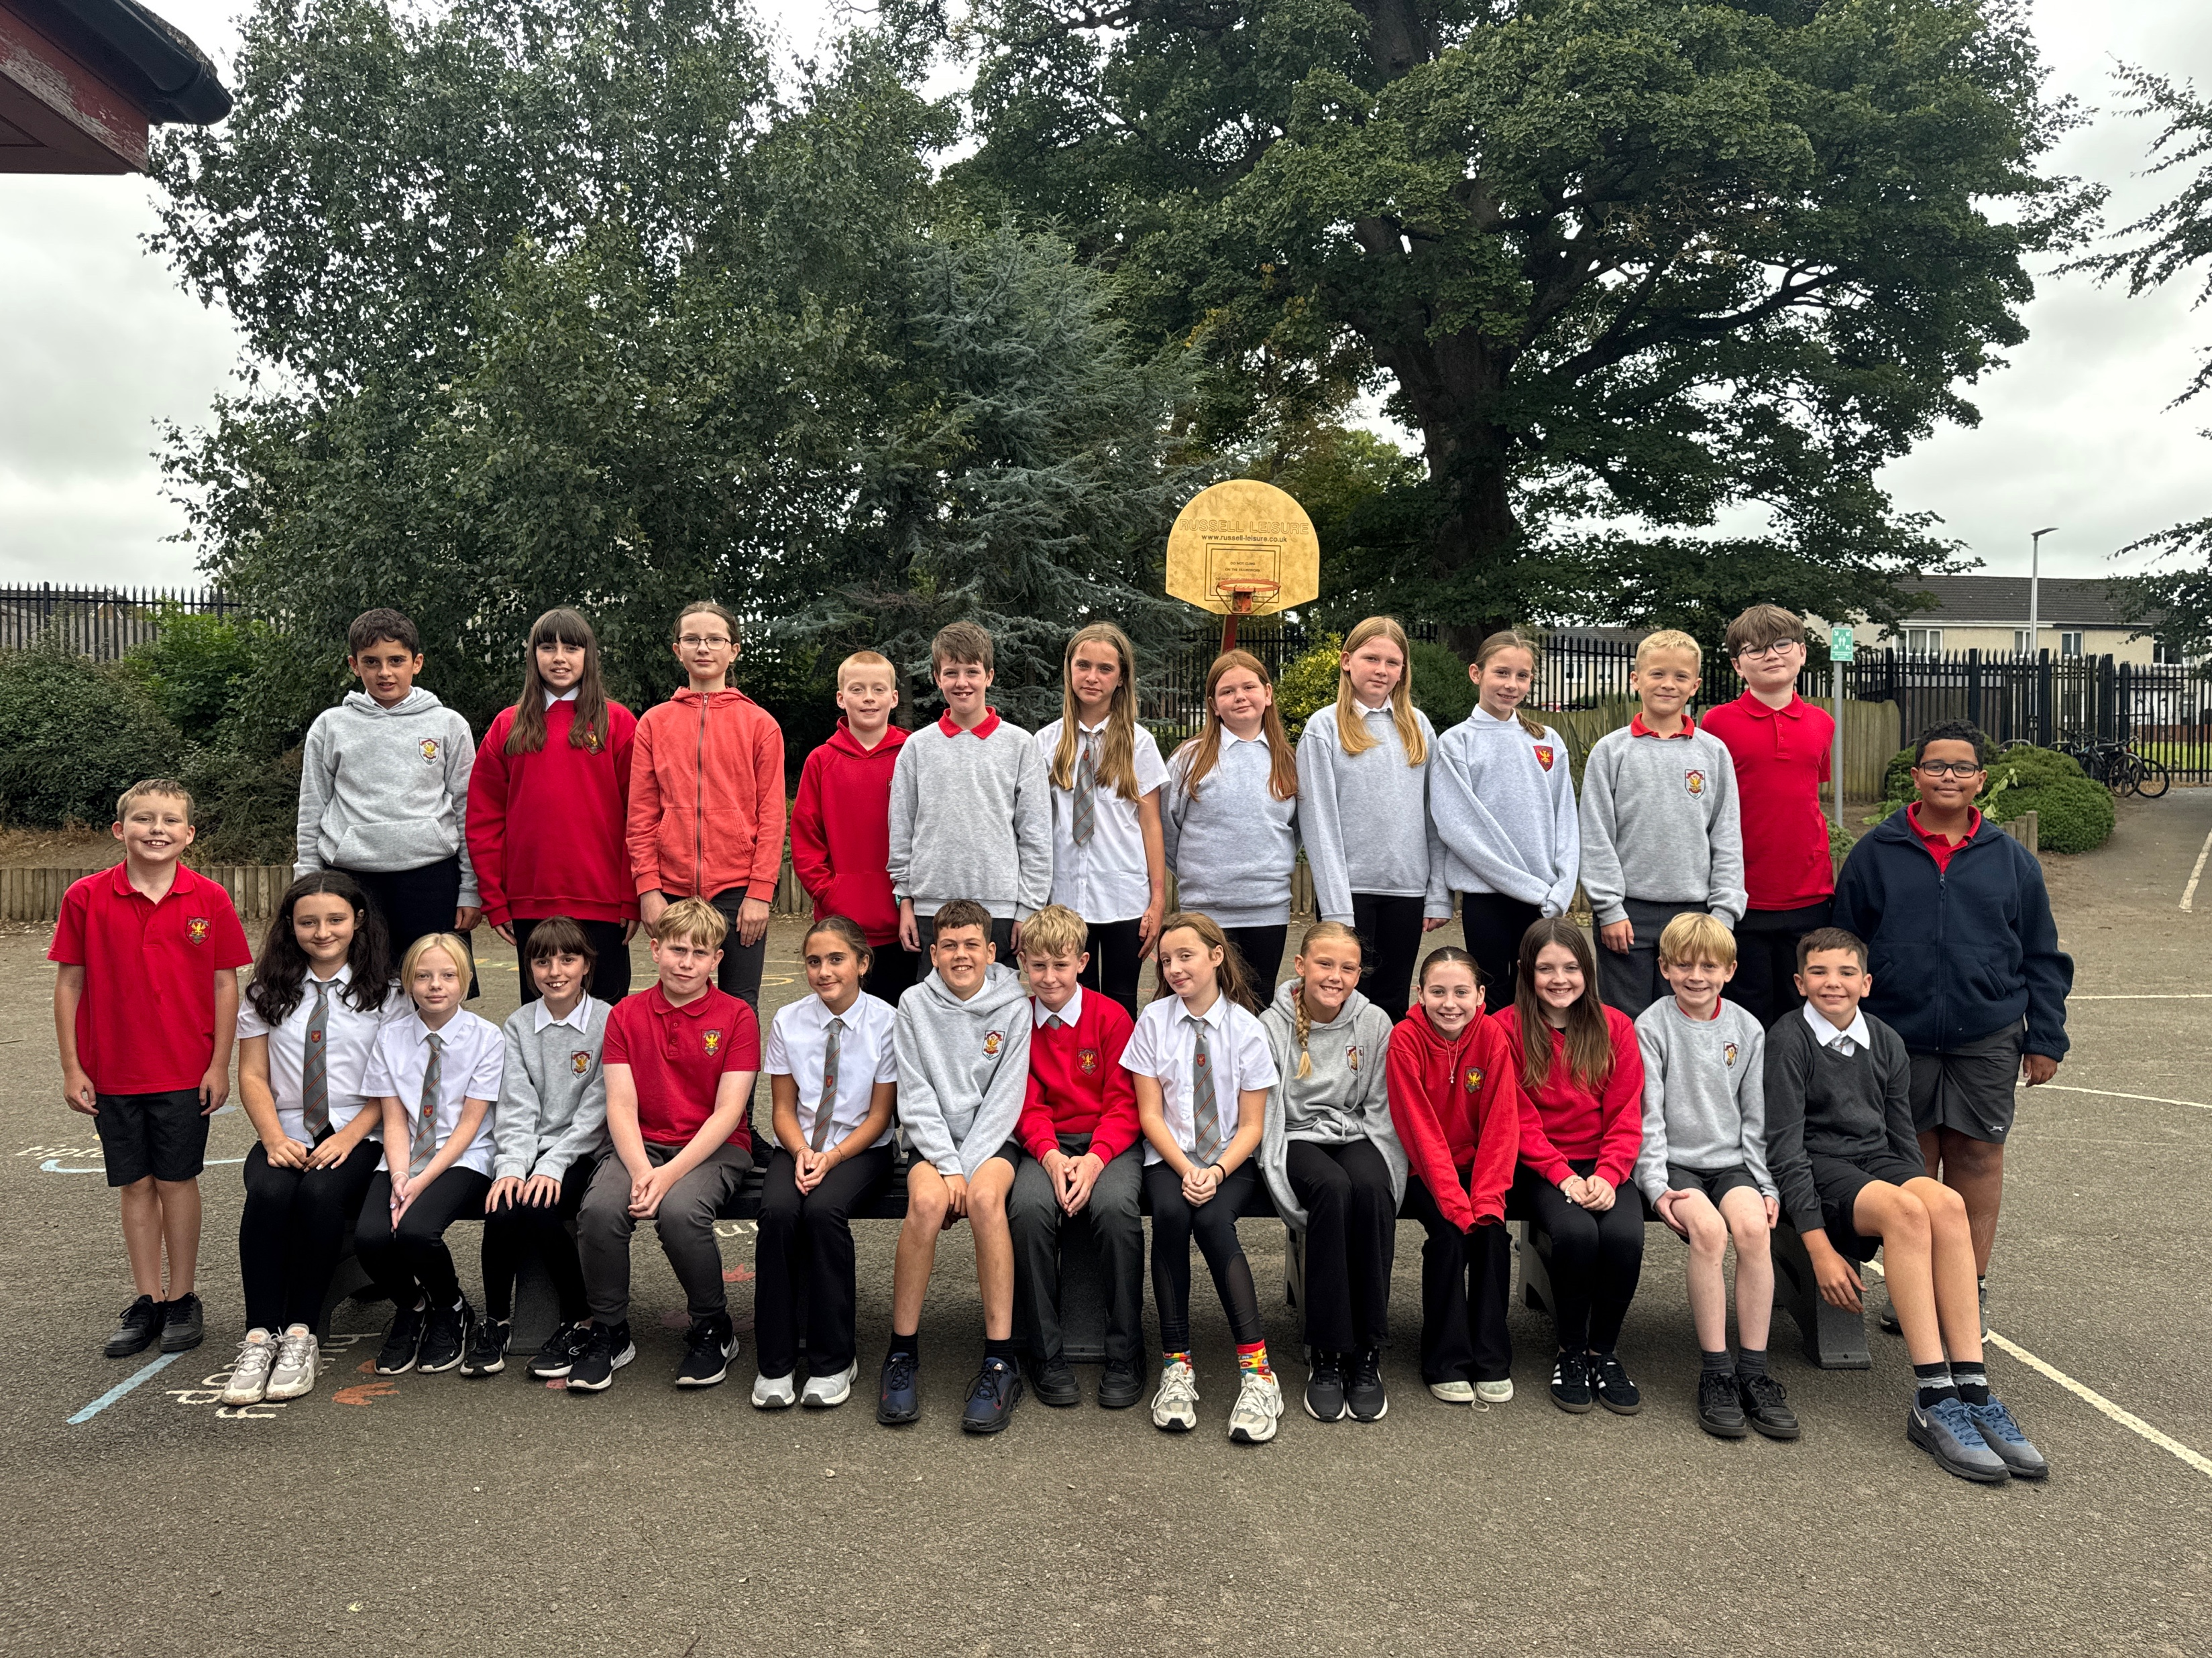

Slide 3

Structure of the School Day
Monday to Thursday
8.00 Breakfast Club (Optional)
8.30 Playground supervision
8.45 School Day starts
10.30-10:45 Break
12.30-1:10 Lunch
15.05 End of School Day
Friday
As above but…
12.25 End of School Day

Slide 4
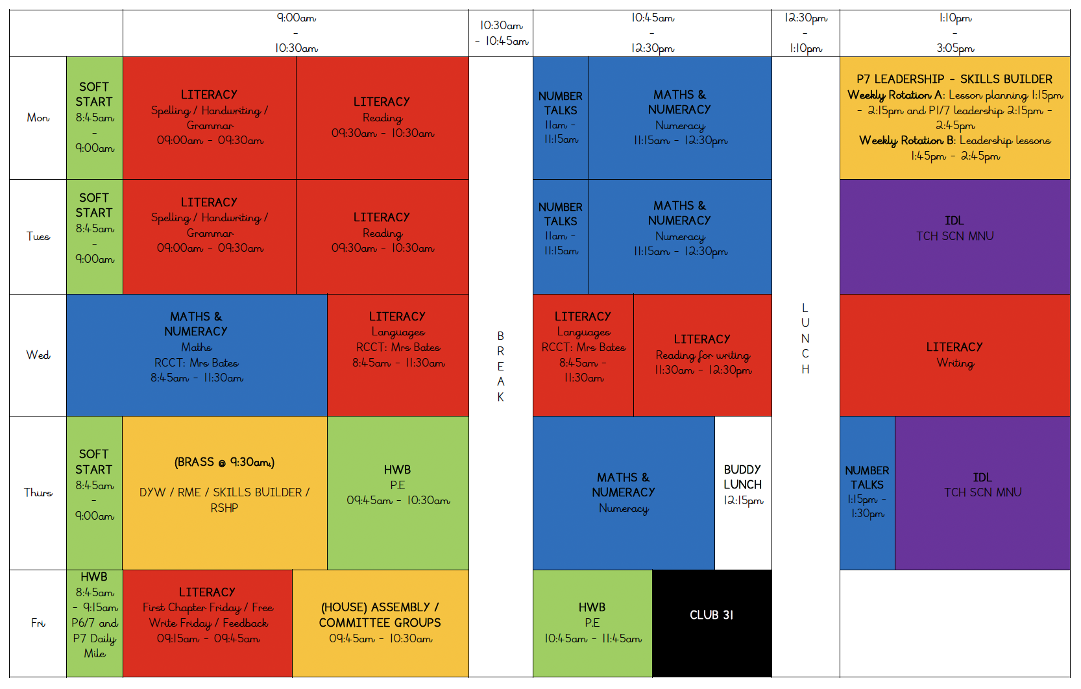
Weekly Timetable
All pupils are entitled to learn about all subject areas. Sometimes these are taught on their own and other subjects are incorporated within IDL. All areas of the curriculum will be covered in Primary 7.

Slide 5


School Uniform
Grey trousers/skirt/ shorts and white shirt/blouse and red & grey striped school tie (grey/red cardigan optional)
Grey trousers/skirt / shorts and red school polo shirt with school badge and grey school sweatshirt with school badge
Grey school cardigan
Summer: Red and white gingham dress with red or grey cardigan
P.E. Kit: As we promote physical activity and outdoor learning, we recommend pupils wearing school logo joggers and jumpers on active days. Please also provide wellies, jackets, sunscreens etc. where appropriate –we aim to be outside in all weathers so please ensure your child is equipped for the day and changing elements!
PLEASE NAME EVERYTHING!
*Nearly New/Used Uniform Available from School Uniform ‘Swap Shop’
Any clothing donations welcome.

Slide 6


Lunchtime Reminder
School lunches are ordered daily through iPay impact – All P1-5 children are entitled to free school dinners
You can look at the lunches at home with your child and YOU MUST pre order your child’s lunch – This applies to all lunches, including a Friday.

Slide 7
Important Documents
Please return the photo permission forms and EE2 forms as soon as possible if you haven’t already done so. We cannot share any photos to the school website until these are returned.
Please ensure that all medical forms are filled in fully and handed back promptly with any appropriate medication.
We cannot issue medication to children unless the relevant form is completed and boxed/prescription information is shared.
Please update the school office if there are any healthcare changes during the year.
This is only relevant to you if you are changing any forms (medical / photos). This can be done via the office.

Slide 8




Interdisciplinary Learning (IDL)
Across our school we use consultative planning methods which means that our “topic” based learning comes from our pupils.
The focus and content of this learning is determined by questions, investigations and interests from our children – they help to design what they would like to learn.
The teacher then crafts and builds activities to support and develop this learning, alongside curriculum experiences, outcomes and planned assessments using our national Curriculum For Excellence benchmarks.
This term, our learning context will begin with “Holes” by Louise Sachar and then “Titanic / Sub Sea”.

Slide 9

Literacy – Reading
We will be focussing on key reading skills and developing our independence to introduce these skills in literature circles.
Each child will have a reading book and homework will be set each week. This may be specific pages, or tasks.

Slide 10
Literacy – Writing
We are using the PM writing scheme to focus on key writing skills which will link with other curricular areas.
Our first context for learning is ‘Narrative’ and letter writing.

Slide 11


Literacy – Listening & Speaking
We will focus on listening and talking throughout the term. We will incorporate this during our IDL and reading lessons.

Slide 12
Literacy – Listening and Talking
Opportunities for Listening and Talking:
Guided reading sessions
Learning discussions – writing
Number Talks
Group tasks/Partner work
Check in/news time
Prepared class talks
Whole school assemblies
Leadership Lessons
House and Vice Captains

Slide 13
Literacy – Spelling
We will continue to follow the ‘Phonics International’ spelling programme.
Children will focus on a new spelling rule each week and there will be tasks to develop these skills alongside homework.

Slide 14



Numeracy and Maths
Numeracy – The focus this term will begin with Multiples, factors and primes, and then move onto patterns and relationships.
Maths – The focus for this term will be angles, symmetry and and transformation.
We will also continue to develop mental strategies using ‘Number Talks’ and explore problem solving through real life contexts.
We continue to use a range of resources and programmes to support our numeracy and maths.

Slide 15


Health and Wellbeing
UNCRC Focus – Children’s Rights
SOAR Values
Positive relationships – Ready, Respect, Safe
Daily HWB check-ins
Class Charter
One Trusted Adult
WL HWB Trackers

Slide 16

Health and Wellbeing
Throughout P7 we will be focussing on lots of areas within health and wellbeing that will be taught using the RSHP resource and the Emotion Works programme.
PE – Thursday and Friday
Daily Mile – Friday (P6/7 and P7)

Slide 17
House Captains and Leadership Roles
P7 will have the chance to put themselves forward for the following roles:
  House Captain
  Vice Captain
  Leadership Lesson
17th and 18th of September – House Captain presentations. Leadership lesson roles arranged after this.
P7 will take on the important role of ‘buddy’ this year! Every other Monday and a Thursday lunch time,

Slide 18





Skills
Introduce skills builder – common language, consistency and progression across the school.

Slide 19
Pupil Voice
Within the classroom, there are many ways for the class to express their thoughts and opinions. For example, our class bank and class charter.
We will be continuing committee groups
The P7s will have the chance to go for house captains and leadership roles.
We will have house meetings where pupils can share their thoughts and ideas.

Slide 20

Homework
Homework will be posted on our P7 Teams each week. Activities should be completed and uploaded into personal files or completed in their homework jotter. Homework will be issued on a Tuesday and will be due the following Monday morning.
Homework may include; literacy, numeracy and maths and IDL.
How to get onto teams …

Slide 21

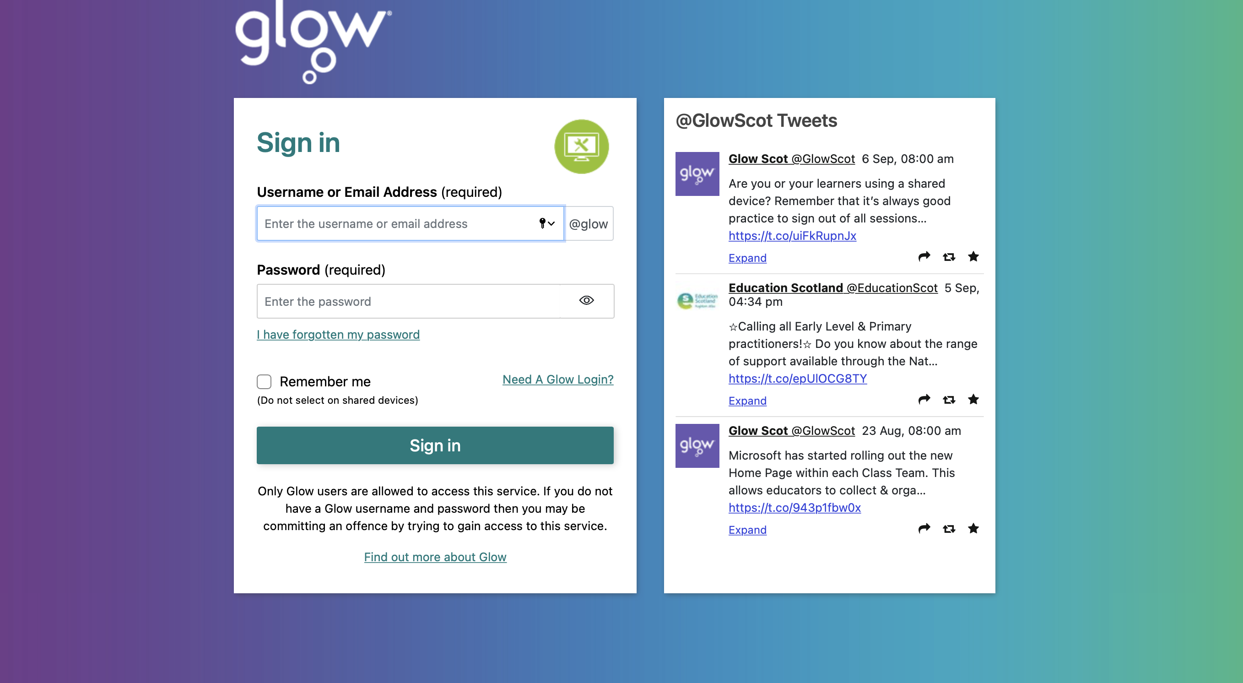

Slide 22
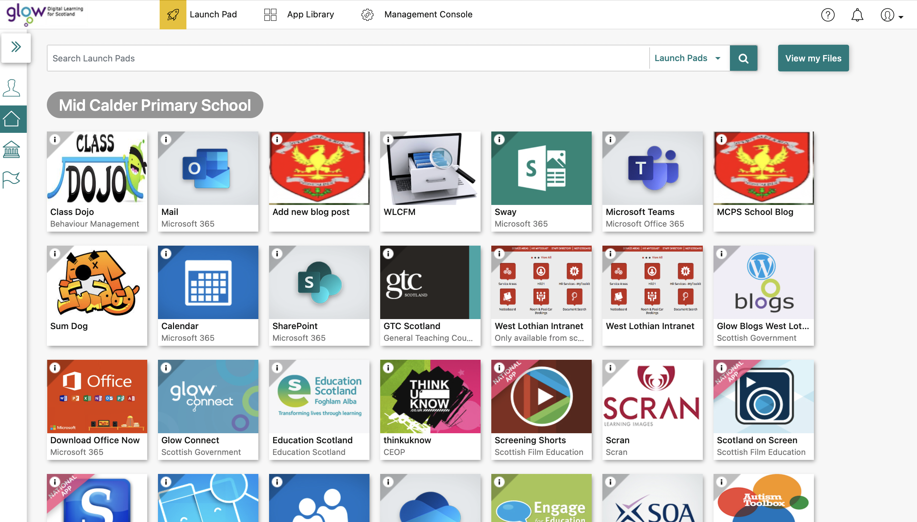

Slide 23
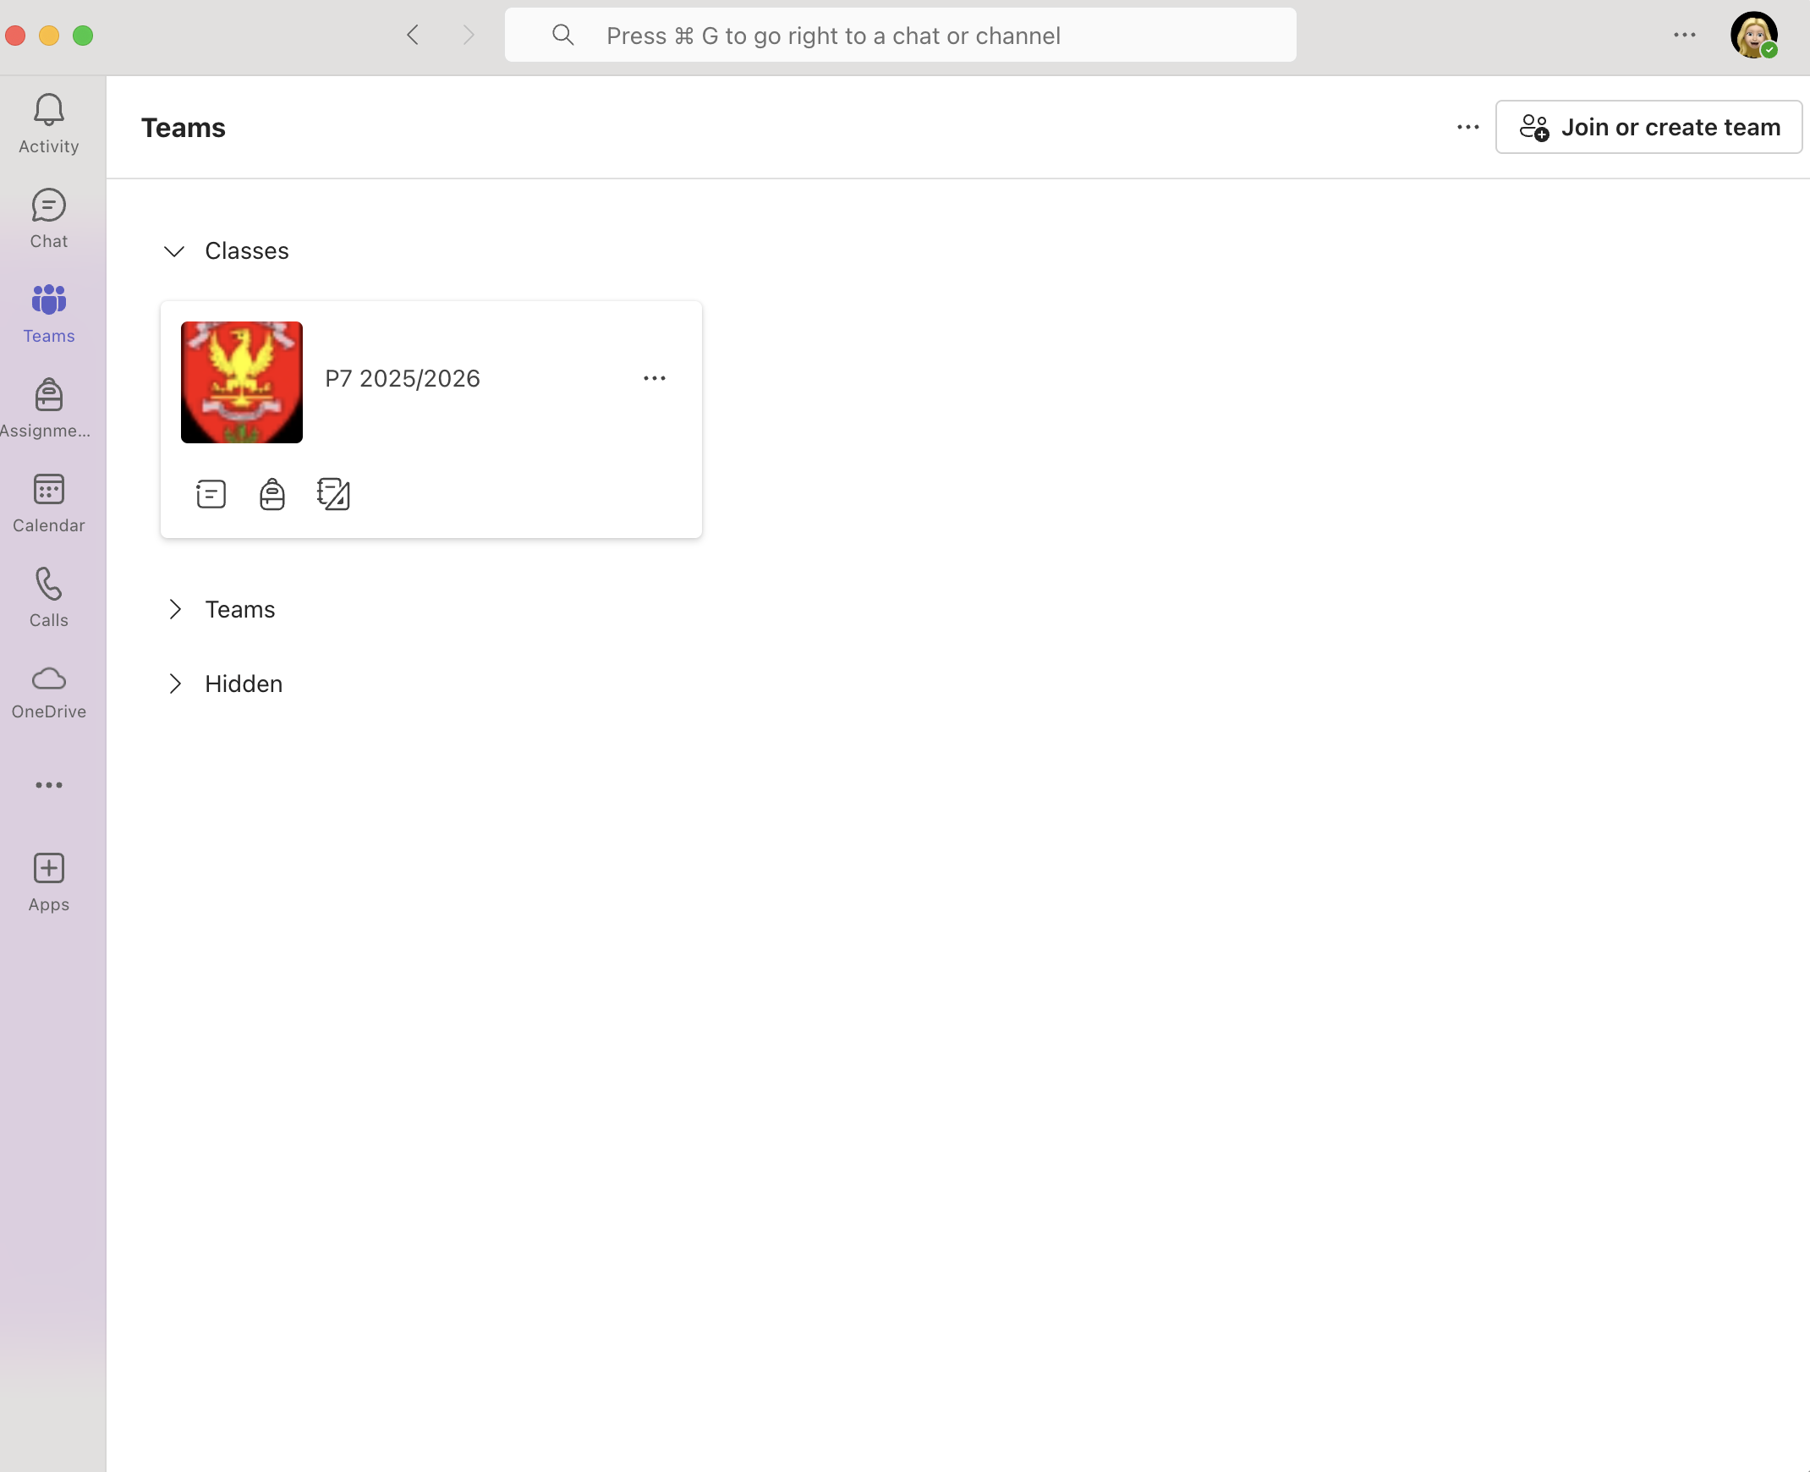

Slide 24
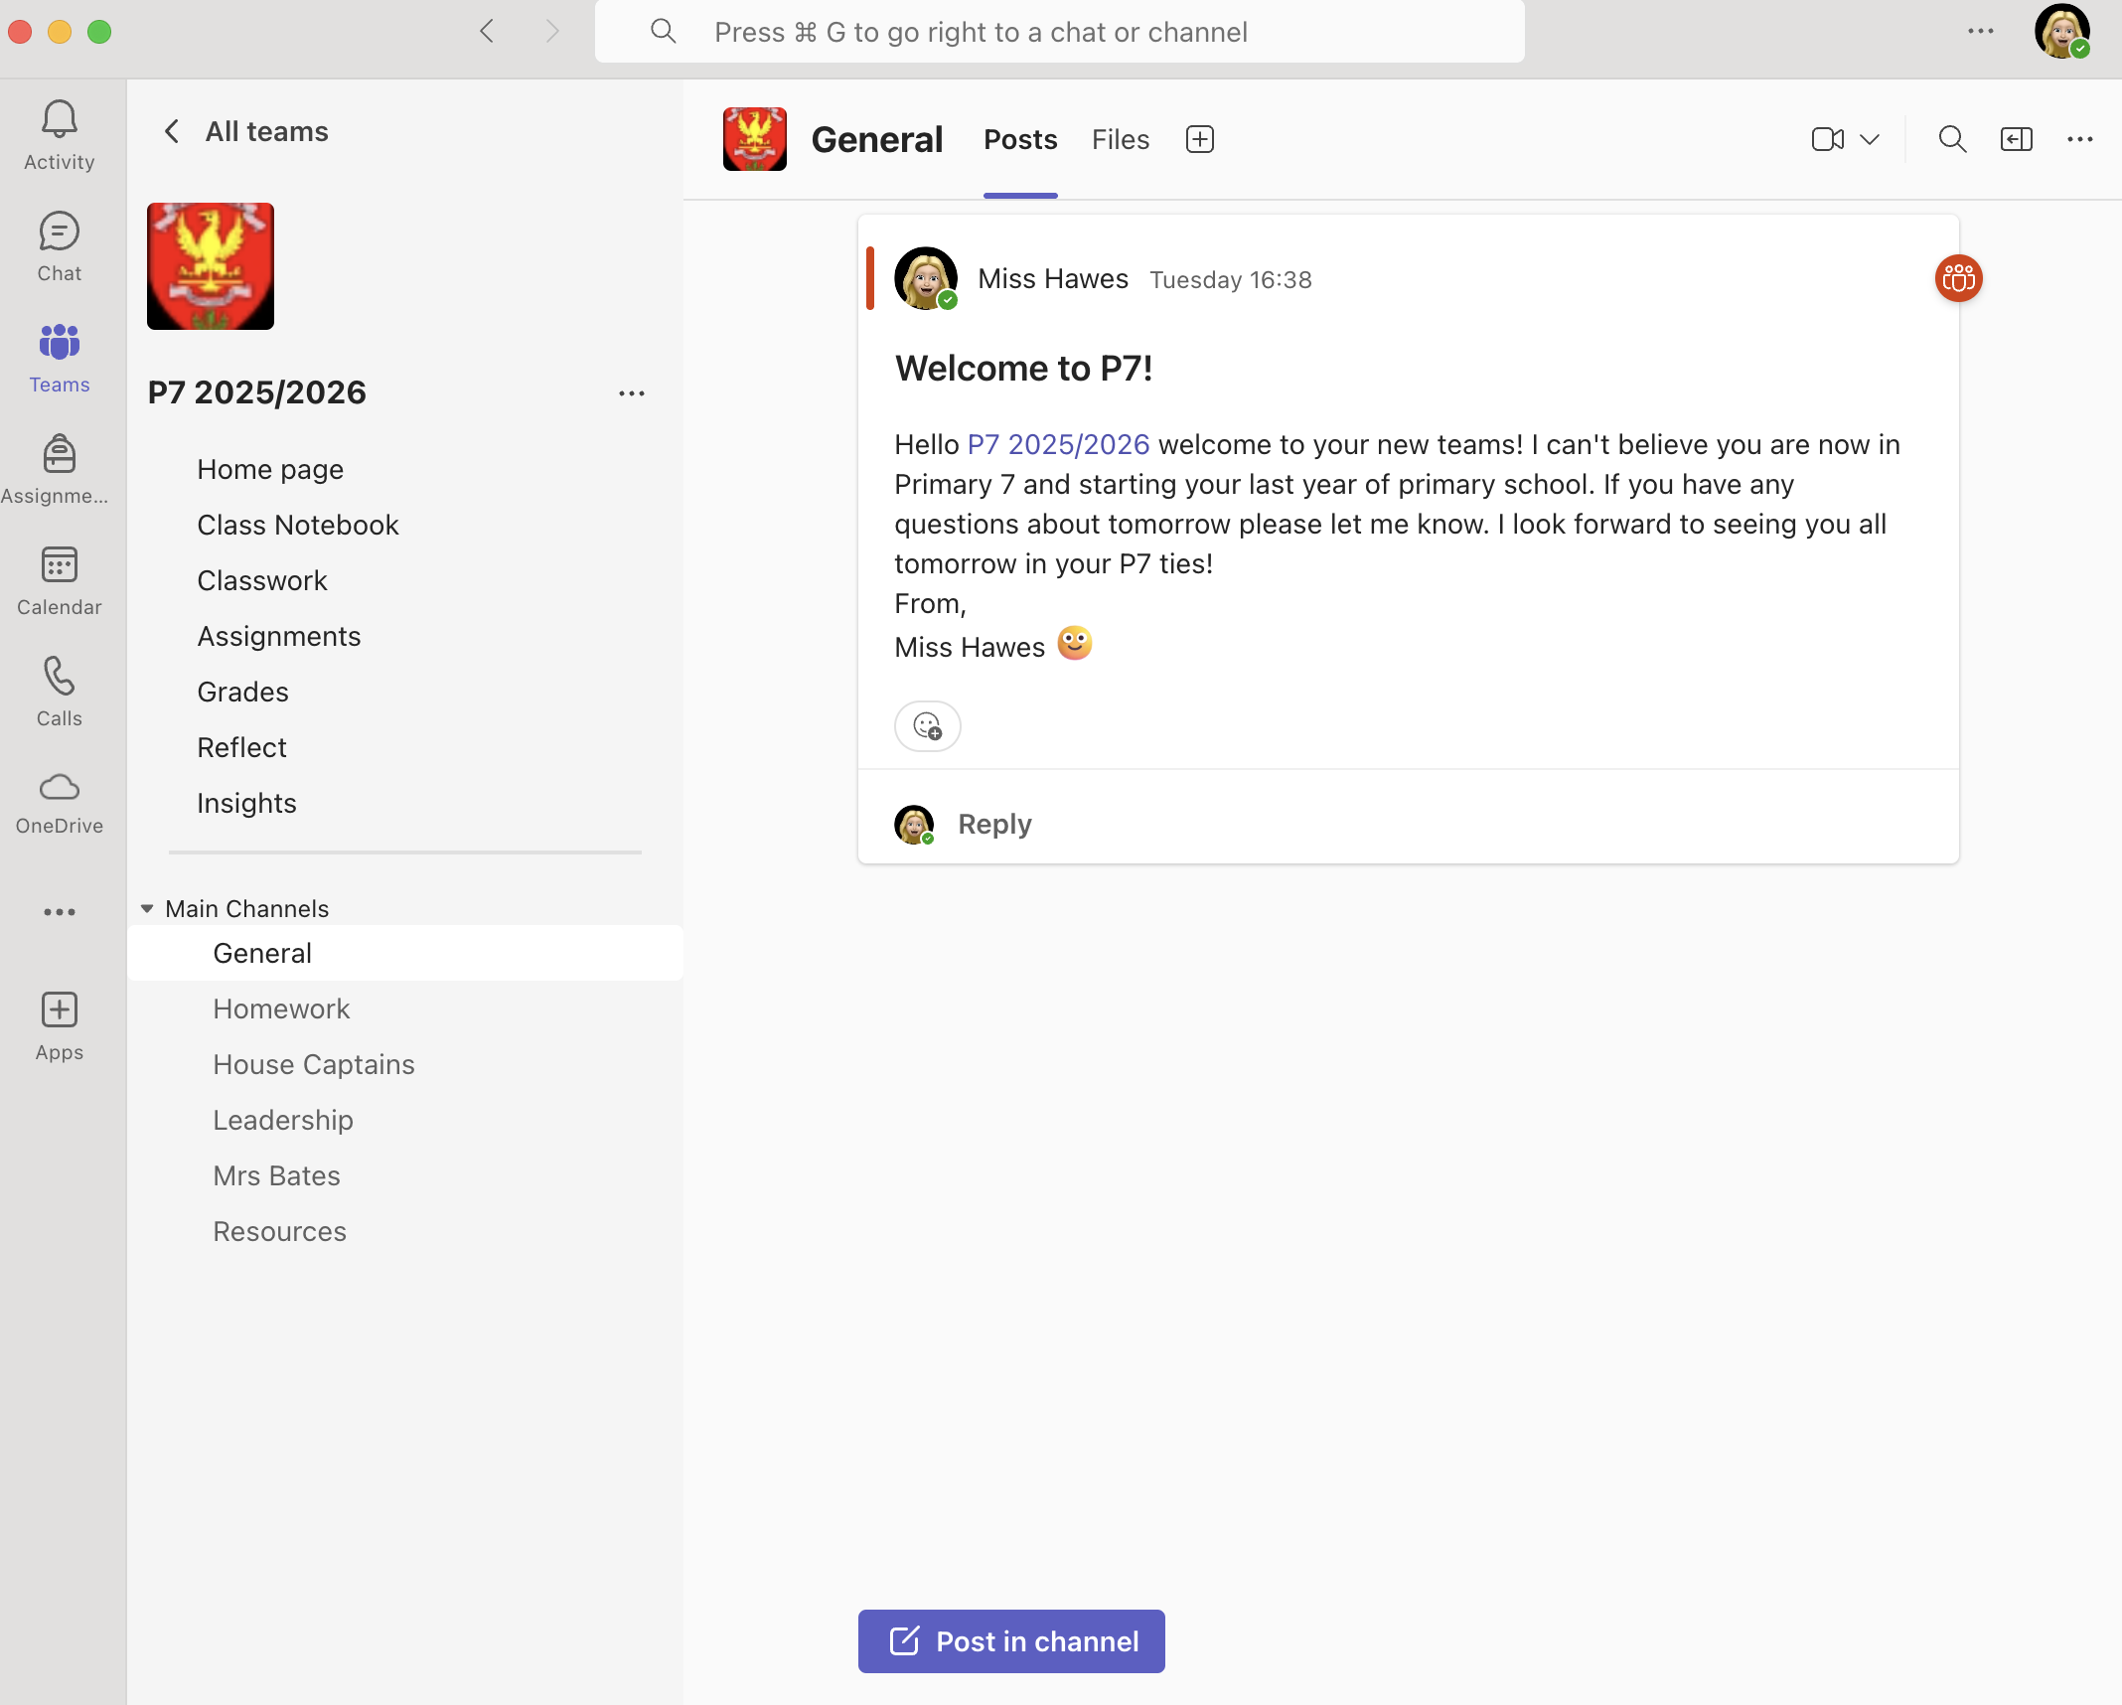

Slide 25
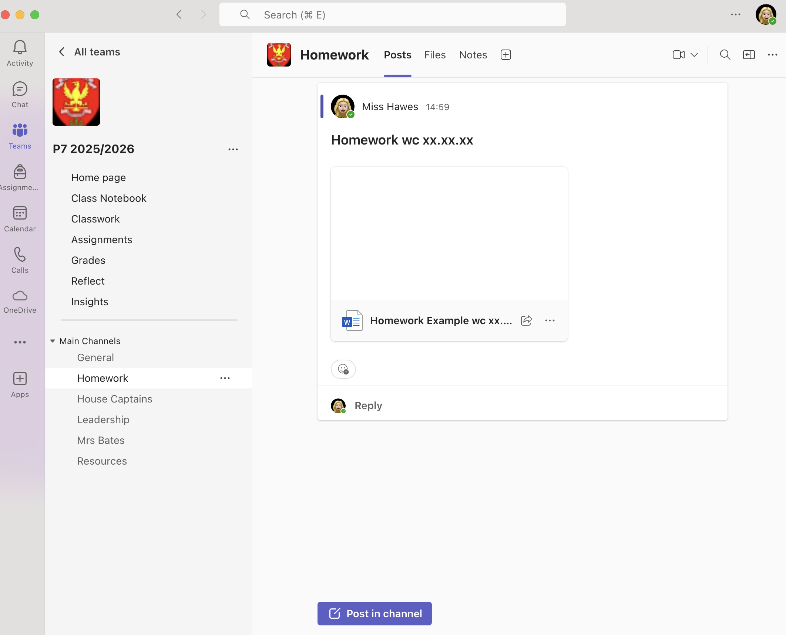

Slide 26
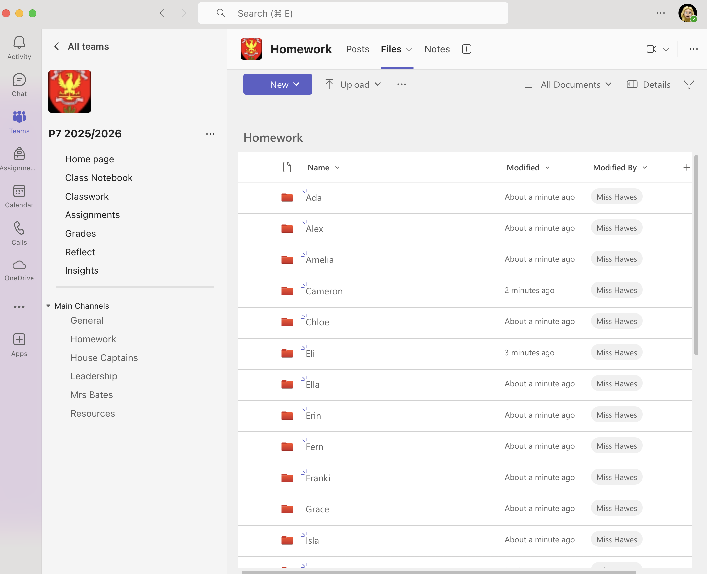

Slide 27
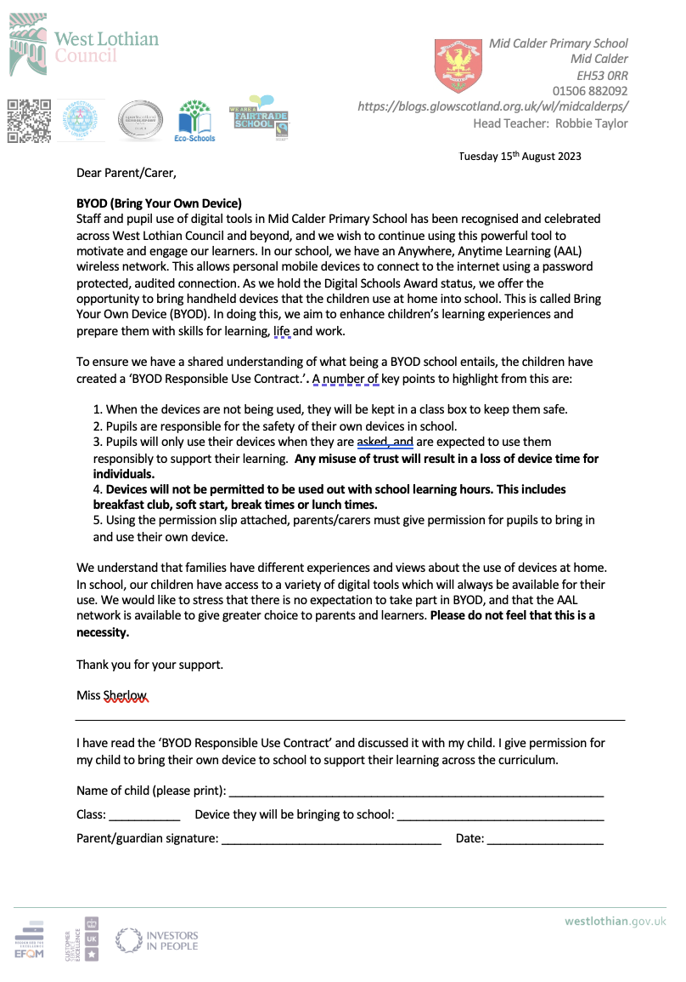

Digital Learning
We are using digital learning every day in P7 and encourage the use of safe digital use outlined in our BYOD form

Slide 28
Digital Learning
Continued use of digital technologies to enhance and engage learning across the curriculum.
Children use a range of devices and digital platforms:
Sumdog
Hit the Button
Top marks
First News
EPIC reading
Procreate
Minecraft
Kahoot
Netbooks
iPads
Spheros
Green screen
Stick bots
Beebots/botleys
BYOD
Blooket

Slide 29
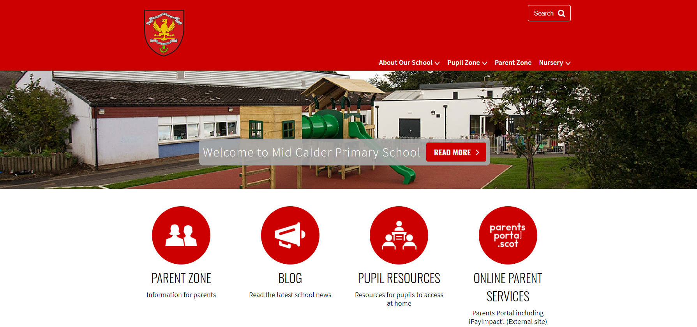
Website: https://midcalderprimary.westlothian.org.uk/

Slide 30
P7 Important Dates
I will share important dates ASAP via the school office.
P7 House Captain presentations (class): 17th September
P7 House Captain presentations (school): 18th September
Parents evening: 14th October 3:30pm – 8:00pm and 15th October 3:30pm – 5:00pm
Parent Pop In: 20th November (1:30pm)
Camp parent and pupil meeting: 25th November 6pm
Parents evening: 10th March 3:30pm – 5:00pm and 11th March 3:30pm – 8:00pm
Camp: 15th – 17th April 2026

Slide 31

Thank you!
Thank you for coming this evening, it’s lovely to see you all!
If you wish to attend a further workshop with another teacher, then please head back to the hall where our P7 helpers will escort you around school.

