Slide 1

Mid Calder Primary School
Primary 5 Meet the Teacher
Mr Renshaw
Tuesday 29th August 2025
2 sessions: 6:00-6:30pm & 6:30-7:00pm

Slide 2
Structure of the School Day
Monday to Thursday
8:00 Breakfast Club (optional)
8:30 Playground supervision
8:45 School Day starts
10:30 - 10:45 Interval
12.30 - 1:10 Lunch
15.05 End of School Day
Friday
As above but…
12:25 End of School Day

Slide 3
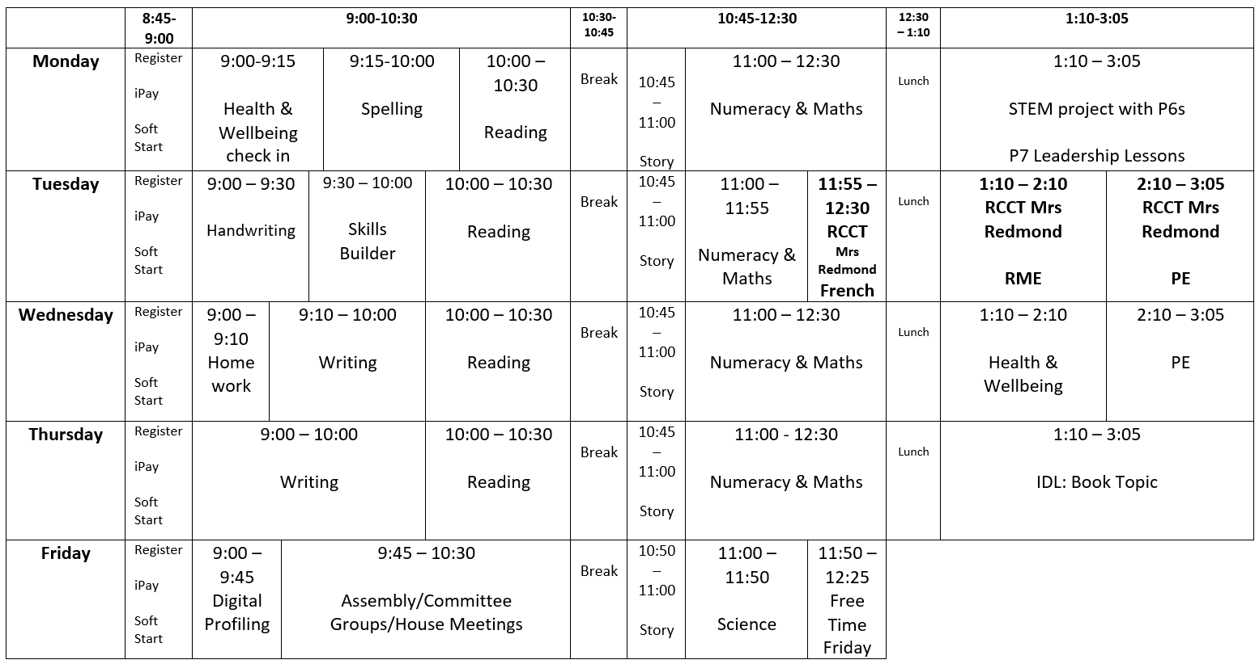
Weekly Timetable – example for term 1

Slide 4
School Uniform
Grey trousers/skirt/ shorts and white shirt/blouse and red & grey striped school tie (grey/red cardigan optional)
Grey trousers/skirt / shorts and red school polo shirt with school badge and grey school sweatshirt with school badge
Grey school cardigan
Summer: Red and white gingham dress with red or grey cardigan
P.E. Kit: As we promote physical activity and outdoor learning, we recommend pupils wearing school logo joggers and jumpers on active days. Please also provide wellies, jackets, sunscreens etc where appropriate –we aim to be outside in all weathers so please ensure your child is equipped for the day and changing elements!
PLEASE NAME EVERYTHING!
*Nearly New/Used Uniform Available from School Uniform ‘Swap Shop’
Any clothing donations welcome.

Slide 5
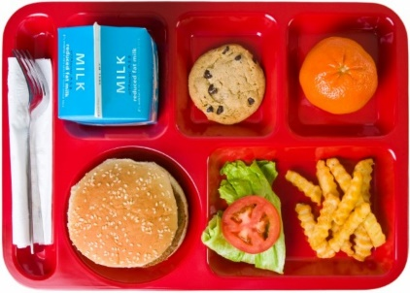
Lunchtime Reminder
School lunches are ordered daily through iPay impact – All P1-5 children are entitled to free school lunch
You can look at the lunches at home with your child and pre order your child’s lunch.
Any problems with accessing iPay please call our School office

Slide 6
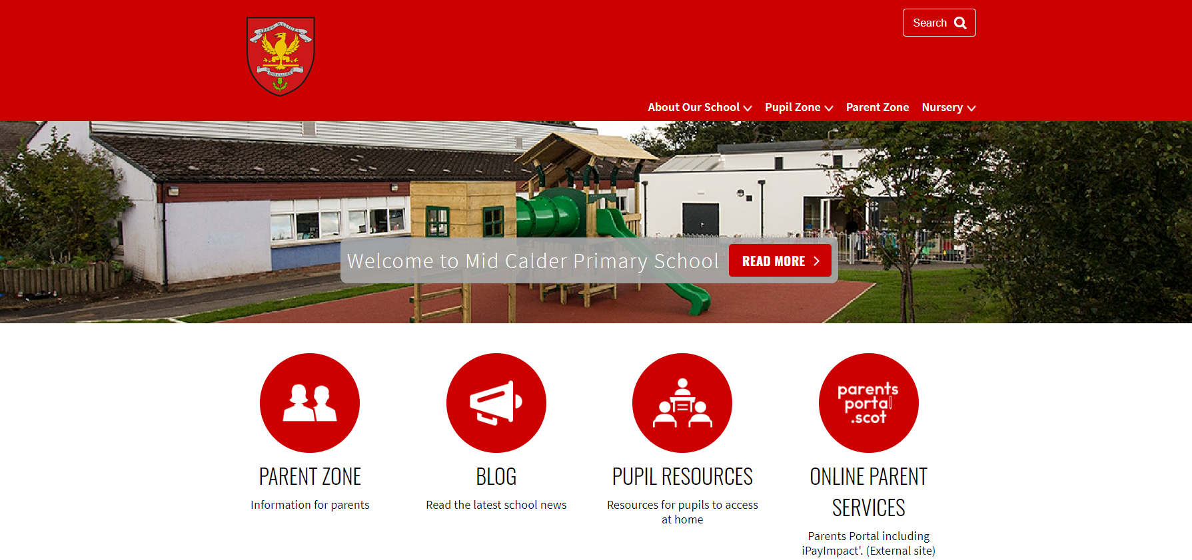
Website: https://midcalderprimary.westlothian.org.uk/
Look out for our monthly school newsletter email for more updates and dates for your diary.

Slide 7
Important Documents
Please return EE2 forms as soon as possible if you haven’t already done so.
Photo permissions will carry on from 2024/25 so please inform the school office if you would like to make any changes.
Please ensure that any medical forms are filled in fully and handed back promptly with any appropriate medication.
We cannot issue medication to children unless the relevant form is completed and boxed/prescription information is shared.
Please update the school office if there are any changes to address, phone number, medication etc. during the year.

Slide 8





Interdisciplinary Learning (IDL)
Across our school we use consultative planning methods which means that our “topic” based learning comes from our pupils.
The focus and content of this learning is determined by questions, investigations and interests from our children – they help to design what they would like to learn.
The teacher then crafts and builds activities to support and develop this learning, alongside curriculum experiences, outcomes and planned assessments using our national Curriculum For Excellence benchmarks.
This term, our learning context will begin with:
Class Novel focus: Mr Penguin and the Lost Treasure

Slide 9
Literacy – Reading
We will be focusing on key reading skills and developing confidence, fluency and understanding.​
Some activities will focus on different text genres and these will link closely to learning in Writing lessons.
There will be frequent opportunities for reading for enjoyment from our school/class library and online resources.​
Each child will have a group reading book and homework will be set each week. This may be specific pages, or tasks.​

Slide 10
Literacy – Writing
We are using the PM writing scheme to focus on key writing skills which will link with other curricular areas.​
Our core writing genres this year will be narrative, procedure, exposition and explanation.
We will develop handwriting skills using the Letter-join Handwriting Programme.​

Slide 11


Literacy – Listening and Talking
Listening and talking skills will be embedded across lots of curricular areas – with particular focus on our IDL topics.​
These skills will be enhanced by our Skills Builder programme.

Slide 12
Literacy – Listening and Talking
Opportunities for Listening and Talking:​
Guided reading sessions​
Number Talks​
Group tasks/partner work​
Check in/news time​
Prepared class talks​
Whole school assemblies​

Slide 13
Literacy – Spelling
We will continue to follow the ‘Phonics International’ spelling programme.​
Children will focus on a new spelling rule each week and there will be activities to develop these skills in class alongside weekly homework.

Slide 14

Numeracy and Maths
A balance of Numeracy and ‘Beyond Number’ concepts (e.g. shape, time etc.) will be taught. ​
Mental maths strategies will be developed using the ‘Number Talks’ programme.​
We will continue to use a range of resources and programmes to support learning in Numeracy and Maths.

Slide 15


Our Health and Wellbeing
UNCRC Focus – Children’s Rights​
SOAR Values​ (Successful, Optimistic, Adventurous, Respectful)
Positive relationships – Ready, Respect, Safe​
Daily check-ins​
Class Charter​
One Trusted Adult​

Slide 16
Health and Wellbeing
Throughout the year, different aspects of Health and Wellbeing will be taught using the RSHP resource (https://rshp.scot/) and the Emotion Works programme. ​
Term 1 topics:
  Friends & friendships
  Social media/popular culture
  A fair and equal life for boys and girls
PE – Tuesday & Wednesday

Slide 17
Homework
Homework will be posted online each week using Microsoft Teams. Homework will consist of Numeracy/Maths and Spelling activities alongside occasional IDL activities. Reading books will be sent home each week with set pages to read.​
More details will follow after the September break.

Slide 18

Digital Learning
Continued use of digital technologies to enhance learning across the curriculum.
Optional Bring Your Own Device (BYOD) in P5. See information letter.
Children use a range of devices and digital platforms:
Sumdog
Hit the Button
Top marks
First News
EPIC reading
Procreate
Kahoot
Netbooks
iPads
Spheros
Green screen
Stick bots
Beebots/botleys
Blooket

Slide 19






Skills
We use the Skills Builder programme in school to provide a common language for skills and skills progression across the school. ​

Slide 20
Pupil Voice
Pupil voice is an important part of the UNCRC rights of a child.​
We run pupil committee groups for P1 – P7, for example, Eco group, Pupil Parliament etc.

Slide 21
Upcoming important dates
Parent consultations:
  Tuesday 14th October & Wednesday 15th October
Parent pop-in:
  Thursday 20th November

Slide 22
Any Questions?
Thank you for attending this session. Please feel free to ask any questions you may have. If you would like to be in touch about your child, please make an appointment with the school office.

