Slide 1

Mid Calder Primary School
Primary 4 Meet the Teacher
Miss Sherlow and Mrs Walker
Tuesday 26th August 2025

Slide 2

Structure of the School Day
Monday to Thursday
8.00 Breakfast Club (Optional)
8.30 Playground supervision
8.45 School Day starts
9:00 Morning Session 1
10.30 Break
10:45 Morning Session 2
12.30 Lunch
1.10 Afternoon Session
15.05 End of School Day

Slide 3
Structure of the School Day
Friday
8.00 Breakfast Club
8.30 Playground supervision
8.45 School Day starts
9:00 Morning session 1
9:45 Assembly
10.30 Break
10:45 Morning Session 2
12:00 Fun Friday
12.25 End of School Day

Slide 4
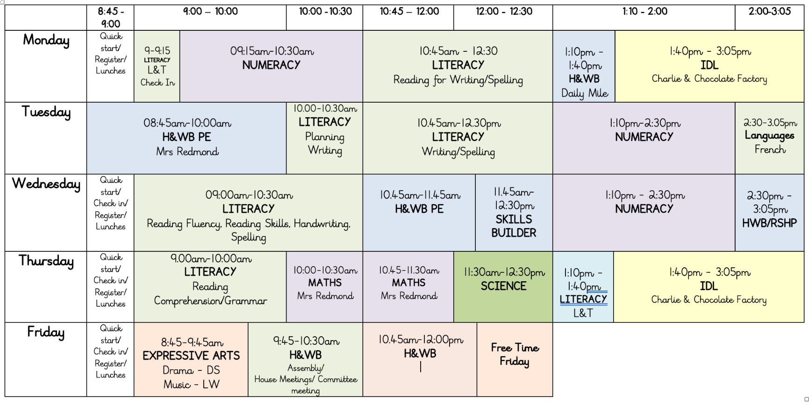
Weekly Timetable

Slide 5
School Uniform
Grey trousers/skirt/ shorts and white shirt/blouse and red & grey striped school tie (grey/red cardigan optional)
Grey trousers/skirt / shorts and red school polo shirt with school badge and grey school sweatshirt with school badge
Grey school cardigan
Summer: Red and white gingham dress with red or grey cardigan
P.E. Kit: As we promote physical activity and outdoor learning, we recommend pupils wearing school logo joggers and jumpers on active days. Please also provide wellies, jackets, sunscreens etc where appropriate –we aim to be outside in all weathers so please ensure your child is equipped for the day and changing elements!
PLEASE NAME EVERYTHING!
*Nearly New/Used Uniform Available from School Uniform ‘Swap Shop’
Any clothing donations welcome.

Slide 6
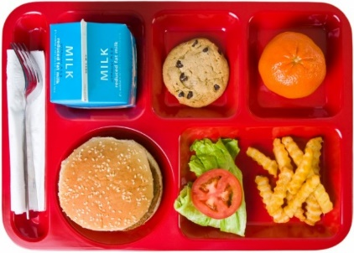
Lunchtime Reminder
School lunches are ordered daily through iPay impact – All P1-5 children are entitled to free school lunch
You can look at the lunches at home with your child and pre order your child’s lunch.
Any problems with accessing iPay please call our School office

Slide 7
Important Documents
Please ensure that all medical forms are filled in fully and handed back promptly with any appropriate medication.
We cannot issue medication to children unless the relevant form is completed and boxed/prescription information is shared.
Please update the school office if there are any changes to address, phone number, medication etc. during the year.

Slide 8




Interdisciplinary Learning (IDL)
Across our school we use consultative planning methods which means that our “topic” based learning comes from our pupils.
The focus and content of this learning is determined by questions, investigations and interests from our children – they help to design what they would like to learn.
The teacher then crafts and builds activities to support and develop this learning, alongside curriculum experiences, outcomes and planned assessments using our national Curriculum For Excellence benchmarks.
This term, our learning context will begin with
Charlie and the Chocolate factory

Slide 9
Literacy – Reading
We will be continuing to use guided reading sessions to explore key reading skills, such as summarising, predicting, clarifying, questioning and inferencing.
We will also continue to develop our reading comprehension and higher order thinking skills through differentiated tasks.
This term we will initially be reading “Charlie and the Chocolate Factory” as our chosen class novel and IDL focus.

Slide 10
Literacy – Spelling/Phonics
We will continue to follow a spelling progression, using our whole school Phonics International programme, where differentiated activities will be planned with new spelling words and sounds issued each week.

Slide 11
Literacy – Writing
We are using the PM writing scheme to focus on key writing skills which will link with other curricular areas.
Our first context for learning is ‘narrative’.
We will develop handwriting skills across all curriculum areas using the Letter-join Handwriting Programme.
Writing will be linked to our class IDL topic where possible.

Slide 12


Literacy – Listening and Speaking
  Daily opportunities for talking and listening with a partner, in a small group or to the whole class.
  There will also be opportunities across the year to take part in a more formal situation by presenting to the class, along with informal situations like sharing news/ideas.

Slide 13
Literacy – Listening and Speaking
Opportunities for Listening and Speaking:
Reading sessions
Learning discussions
Number Talks
Group tasks/Partner work
Check in/news time
Prepared class talks
Whole school assemblies

Slide 14


Numeracy and Maths
Numeracy – The focus this term will begin with place value and estimation
Maths – The focus for this term will begin with data handling.
We will also continue to develop mental strategies using ‘Number Talks’ and explore problem solving through real life contexts.
Regular Sumdog activities will be set that children can work on at home to consolidate their learning.

Slide 15


Numeracy and Maths
How you can help at home:
Counting forwards and backwards within and beyond 100.
Skip counting in 2s, 5s, 10s, and then in 3s and 6s, 4s and 8s.
Time
Money
Times tables
Maths in real life

Slide 16


Our Health and Wellbeing
UNCRC Focus – Children’s Rights
SOAR Values
Positive relationships – Ready, Respect, Safe
Daily HWB check-ins
Class Charter
One Trusted Adult
WL HWB Trackers

Slide 17
Health and Wellbeing
We use
Zones of regulation for our daily check ins
RSHP education
https://rshp.scot/
Our PE days will be Tuesday and Wednesdays. Children can wear their PE kits to school on these days.
We also walk a mile once a week (Monday)

Slide 18
Homework
Homework will include:
A spelling task
A reading tasks
A numeracy task linked to current learning, or revision of previous learning
It will be set on Tuesdays and be due on Mondays (after September break).

Slide 19





Skills

Slide 20

Digital Learning
Continued use of digital technologies to enhance and engage learning across the curriculum.
Children use a range of devices and digital platforms:
Sumdog
Hit the Button
Top marks
EPIC reading
Procreate
Minecraft
Kahoot
Blookit
Netbooks
iPads
Spheros
Green screen
Stick bots
Beebots/Botleys
Incredibox

Slide 21
Pupil Voice
Pupils are asked to share their thoughts and opinions regularly E.g. Class check in suggestion time, class jobs, IDL,
This year we will be continuing with Committee groups for P1-P3 and P4-P7 covering Eco/Sustainability, Digital, Rights, School designing, Pupil Parliament
House Gatherings meetings

Slide 22
Thank you!
Thank you for coming along this evening, it’s lovely to see you all!
If you wish to attend a further workshop with another teacher, then please head back to the hall where our P7 helpers will escort you around school.

