Slide 1

Mid Calder Primary School
P4/5 Meet the Teacher
Tuesday 26th August

Slide 2
Structure of the School Day
Monday to Thursday:
8.00 Breakfast Club (Optional)
8.30 Playground supervision
8.45 School Day starts
10.30 – 10.45 Morning Break
12.30 – 13.10 Lunch
15.05 End of School Day
Friday:
12.25 End of School Day

Slide 3
P4/5 – 2025/26
Mrs Murray – class teacher
Mrs Redmond – P.E/ Maths - Beyond Number
Mrs Grainger – Support for Learning
Mrs Combe- PSW
Mrs Agarwal - PSW

Slide 4
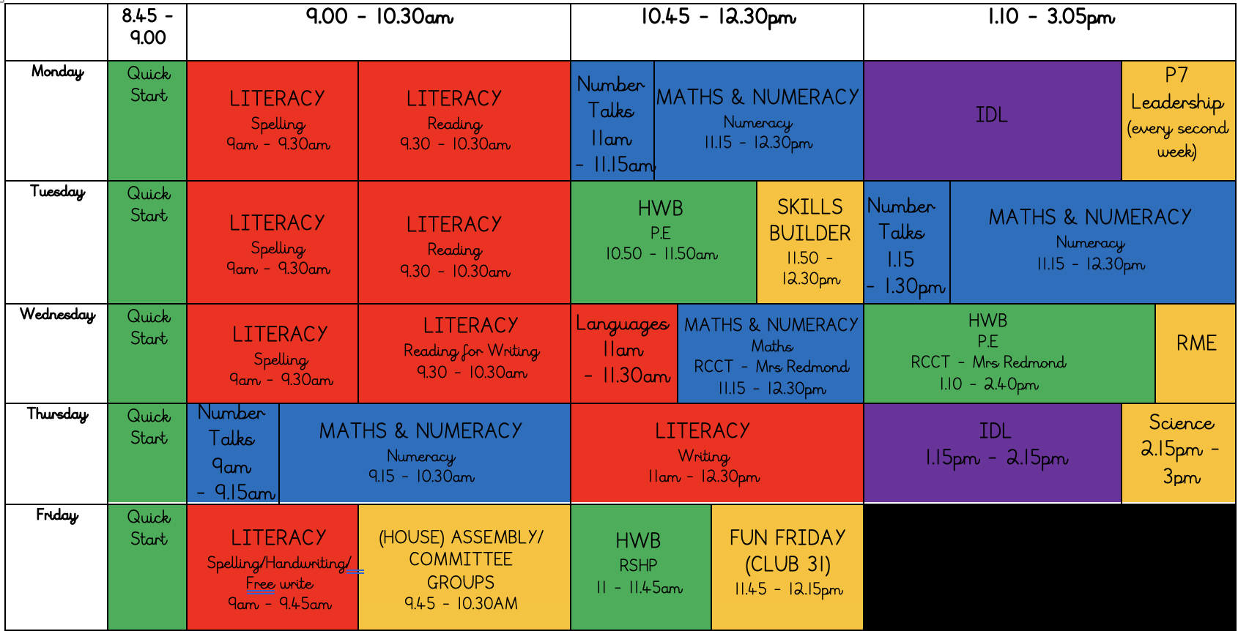
Weekly Timetable

Slide 5
School Uniform
Grey trousers/skirt/shorts
White shirt/blouse and red and grey striped school tie
Red school polo shirt and grey school sweatshirt/red or grey cardigan
Please also provide wellies, jackets, sunscreens etc. where appropriate – we aim to be outside in all weathers so please ensure your child is equipped for the day and changing elements!
PLEASE NAME EVERYTHING!
*Nearly New/Used Uniform Available from School Uniform ‘Swap Shop’
Any clothing donations welcome.

Slide 6
Lunchtime Reminder
School lunches are ordered at home through iPay impact – All P1-5 children are entitled to free school lunches.
Any problems with accessing iPay please call our School office

Slide 7
Important Documents
EE2s have been sent by group call this week. Please return these as soon as possible.
If there are any changes to photo permissions, please let us know.
Please ensure that all medical forms are up to date and any medication is handed in to school.
We cannot issue medication to children unless the relevant form is completed and boxed/prescription information is shared.
Please update the school office if there are any healthcare changes during the year.

Slide 8

Interdisciplinary Learning (IDL)
Across our school we use consultative planning methods which means that our “topic” based learning comes from our pupils.
The focus and content of this learning is determined by questions, investigations and interests from our children – they help to design what they would like to learn.
We then create activities to support and develop this learning, alongside our national Curriculum For Excellence benchmarks.
This term, our learning context will begin with a novel study – The Boy Who Made Everyone Laugh by Helen Rutter.

Slide 9
Literacy – Reading
Guided reading sessions will focus on 4 main reading skills:
Predicting
Summarising
Questioning
Clarifying
Reading for Writing – texts linked to writing focus. Identify structure and features in preparation for extended writing lessons

Slide 10
Reading Homework
Reading books will be sent home on a Tuesday and reading homework should be completed by the following Monday.
Please use your child’s reading record to let us know how reading is going at home. Be honest!
Try to encourage your child to complete this if possible, as the following week’s discussions and task could be about what they have previously read.
Please ensure your child brings their reading book and reading record to school every day, as they may require the book to complete tasks in class.

Slide 11
Literacy – Writing
The Boy Who Made Everyone Laugh:
  Character profiles and descriptions.
  Posters/adverts for comedy club
PM Writing:
  Using our school writing resources, PM writing, we will focus on the following:
  Aug - Oct – Narrative
  Oct – Dec – Procedure
  Jan – March – Exposition
  April – June - Explanation
  We will look at the purpose, structure and features of this type of writing.

Slide 12
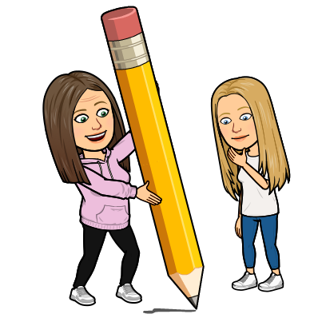
Literacy – Spelling
We will continue to follow ‘Phonics International’ spelling and phonics programme.
Children will learn a new spelling sound every week, with activities in class, alongside homework.
This should be transferred in their writing tasks.

Slide 13


Literacy – Listening and Talking
P4/5 will be offered daily opportunities to become confident individuals, expressing their opinions and sharing learning and experiences.
Children will be encouraged to build confidence when talking to others, focussing on, pace, tone, gesture, eye contact, volume, expression and emphasis.
Children should also show respect for the views of others by responding appropriately in discussions.
Opportunities for Listening and Talking:
Class and group discussions
Learning discussions
Number Talks
Check in/news time
Prepared class talks
Whole school assemblies
Play based learning
Focussed Skills Builder sessions

Slide 14


Numeracy and Maths
Numeracy – the focus this term will be Place Value and the Estimating and Rounding
Maths – the focus for this term will be Data Handling
We will also continue to develop mental strategies using Number Talks and explore problem solving through real life contexts.
We continue to use a range of resources and programmes to support our numeracy and maths.

Slide 15


Health and Wellbeing
UNCRC Focus – Children’s Rights
SOAR Values
  Successful, Optimistic, Adventurous & Respectful
Positive relationships – Ready, Respect, Safe
Daily HWB check-ins
Class Charter
One Trusted Adult
WL HWB Trackers
RSHP
P5 - Residential
P.E – Tuesday and Wednesday

Slide 16








Skills
In Mid Calder we use the Skills Builder Programme.
The programme allows us to support every child build essential skills that will not only help them thrive in school but also in their wider lives.

Slide 17
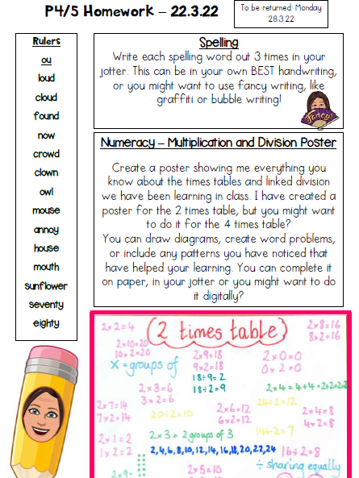
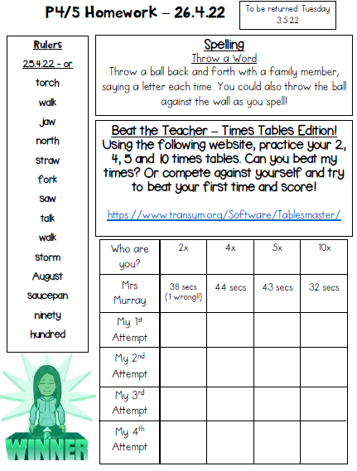
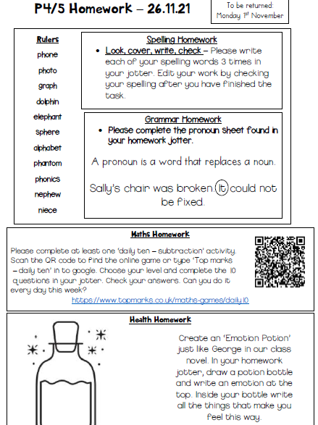
Homework
Homework tasks will be handed out on a Tuesday and should be handed back in to school on a Monday.
Homework will consist of a spelling activity and a maths task. Sometimes there will be a task from another curricular area.

Slide 18

Digital Learning
Continued use of digital technologies to enhance and engage learning across the curriculum.
Children use a range of devices and digital platforms:
Sumdog
Hit the Button
Top marks
First News
EPIC reading
Procreate
Minecraft
Netbooks
iPads
Spheros
Green screen
Stick bots
Beebots/botleys
BYOD – P5

Slide 19
Pupil Voice
Children are at the heart of all our planning and it is important to us that their voice is heard.
Consultative planners – IDL
Class Charter
Set up of Committee groups
House Meetings

Slide 20
Important Dates
Parent Consultation 1 – Tuesday 14th October/ Wednesday 15th October
Parent Consultation 2 – Tuesday 10th March/ Wednesday 11th March
Parent Pop in 1 – Thursday 20th November 1.30pm to 3pm
P4/5 Class Assembly – Friday 14th November – 9.45am
P5 Residential – Wednesday 17th April – Friday 19th April

Slide 21
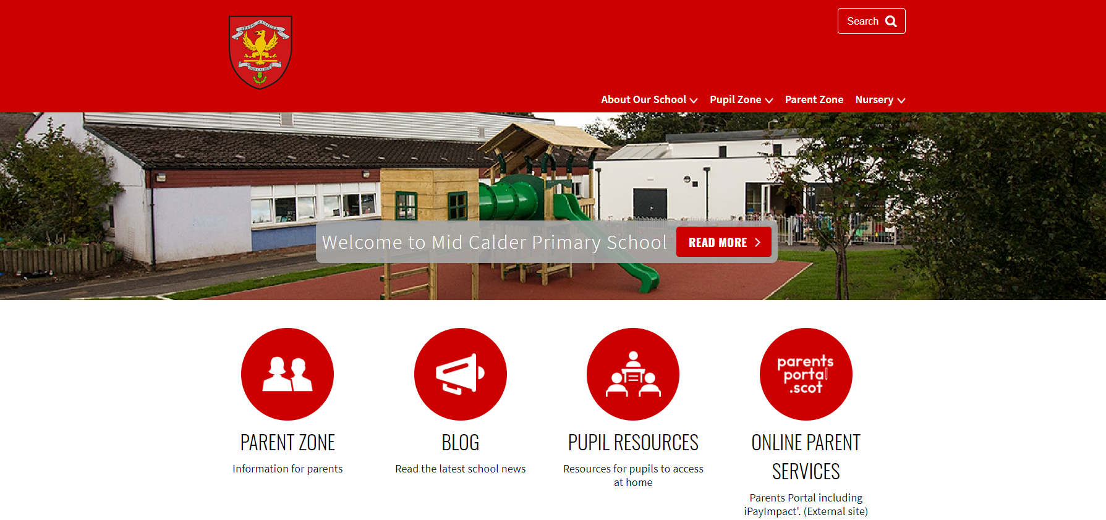
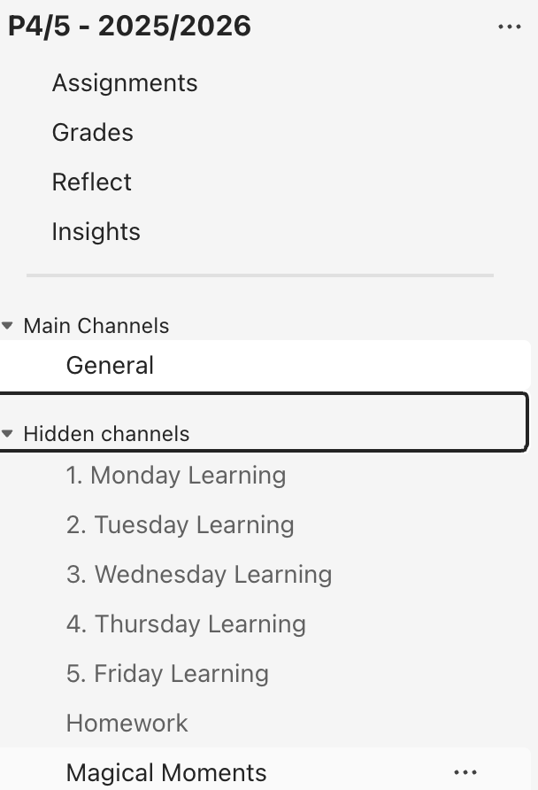
Website: https://midcalderprimary.westlothian.org.uk/
P4/5 Teams page:
School Newsletter
Class Learning Letters
Sway

Slide 22
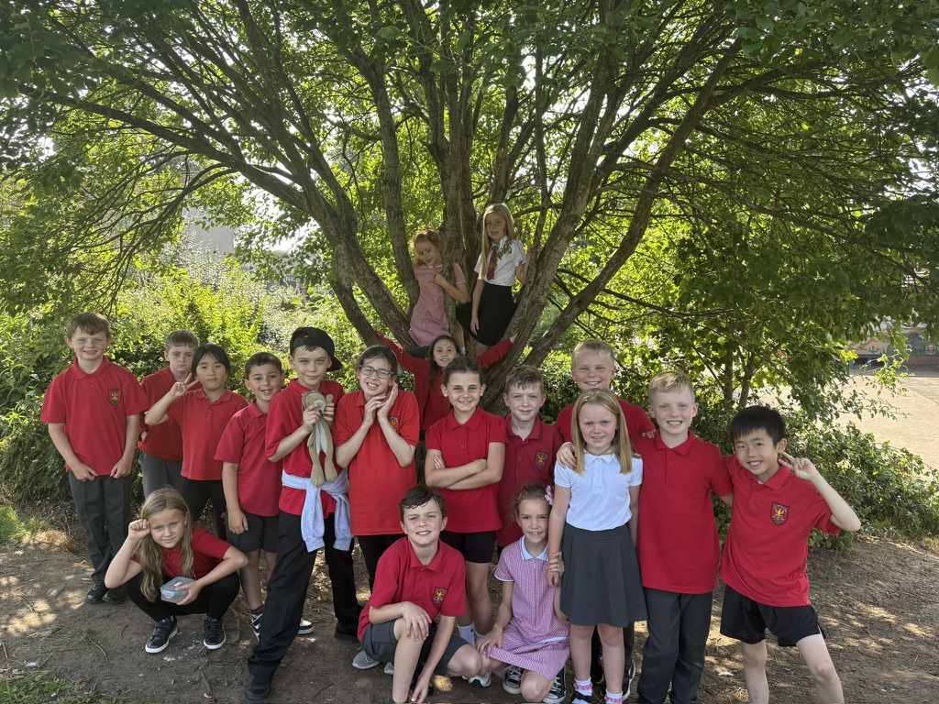
Thank you for coming to support your child and Mid Calder Primary.
Please don’t hesitate to get in touch if you have any questions or queries throughout the year.

