Slide 1

Mid Calder Primary School
Primary 3
Meet Miss Clark
Tuesday 26th August 2025

Slide 2
Structure of the School Day
Monday to Thursday
8.00 Breakfast Club (Optional)
8.30 Playground supervision
8.45 School Day starts
10.30 -10:45 Interval
12.30 – 1:10 Lunch
15.05 End of School Day
Friday
As above but…
12:25 End of School Day

Slide 3
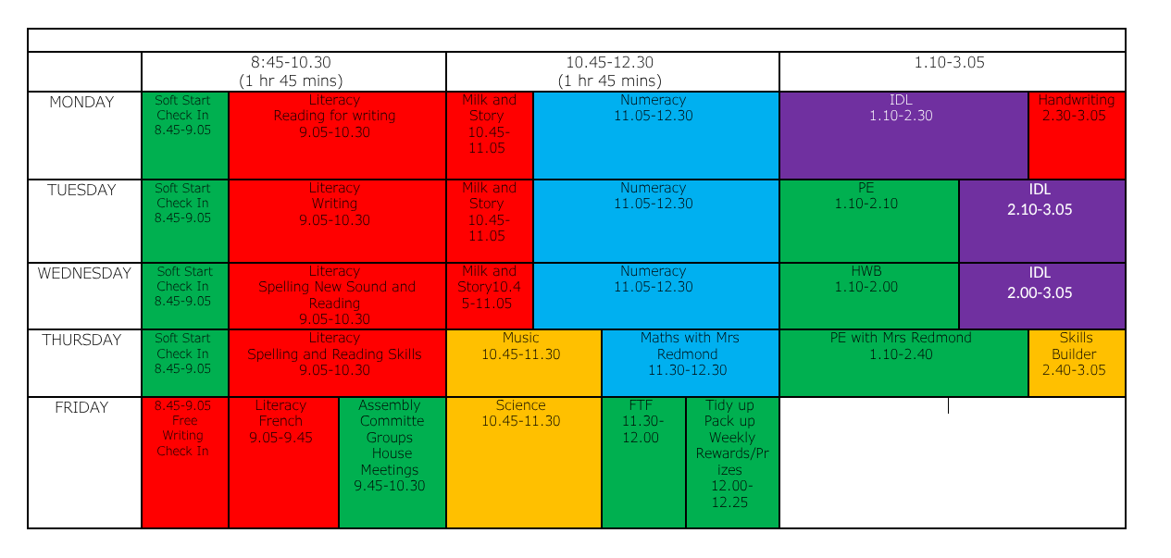
Weekly Timetable

Slide 4
School Uniform
Grey trousers/skirt/ shorts and white shirt/blouse and red & grey striped school tie (grey/red cardigan optional)
Grey trousers/skirt / shorts and red school polo shirt with school badge and grey school sweatshirt with school badge
Grey school cardigan
Summer: Red and white gingham dress with red or grey cardigan
P.E. Kit: As we promote physical activity and outdoor learning, we recommend pupils wearing school logo joggers and jumpers on active days. Please also provide wellies, jackets, sunscreens etc where appropriate –we aim to be outside in all weathers so please ensure your child is equipped for the day and changing elements!
PLEASE NAME EVERYTHING!
*Nearly New/Used Uniform Available from School Uniform ‘Swap Shop’
Any clothing donations welcome.

Slide 5
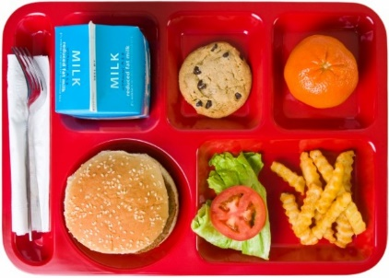
Lunchtime Reminder
School lunches are ordered through iPay impact – All P1-5 children are entitled to free school lunch
You can look at the lunches at home with your child and pre order your child’s lunch.
Any problems with accessing iPay please call our School office

Slide 6
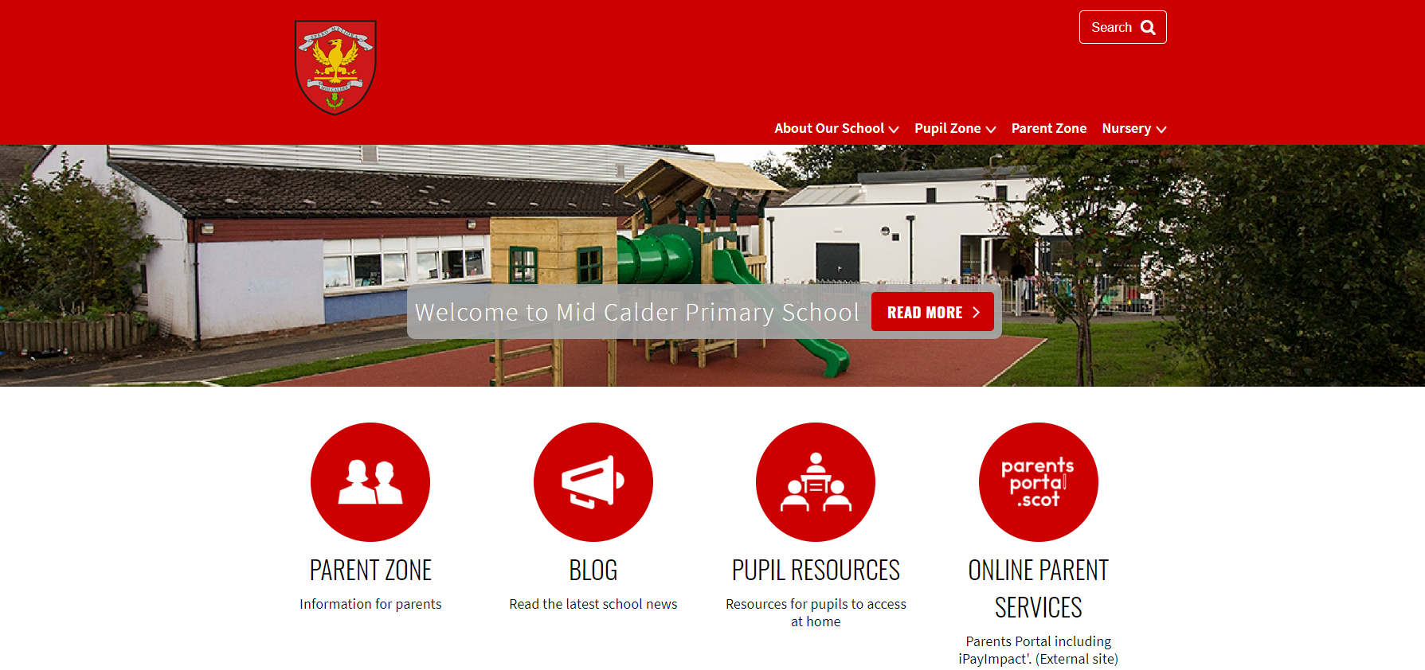


Website: https://midcalderprimary.westlothian.org.uk/
School/Class Newsletter:
Seesaw:

Slide 7
Important Documents
Please return EE2 forms as soon as possible if you haven’t already done so. Please let the office know of any changes to photo permissions from last year. We cannot share any photos on the school website, newsletter or on Seesaw until these are returned.
Please ensure that all medical forms are filled in fully and handed back promptly with any appropriate medication.
We cannot issue medication to children unless the relevant form is completed and boxed/prescription information is shared.
Please update the school office if there are any changes to address, phone number, medication etc. during the year.

Slide 8




Interdisciplinary Learning (IDL)
Across our school we use consultative planning methods which means that our “topic” based learning comes from our pupils.
The focus and content of this learning is determined by questions, investigations and interests from our children – they help to design what they would like to learn.
The teacher then crafts and builds activities to support and develop this learning, alongside curriculum experiences, outcomes and planned assessments using our national Curriculum For Excellence benchmarks.
This term, our learning context will begin with
The Creakers and Rainforests

Slide 9
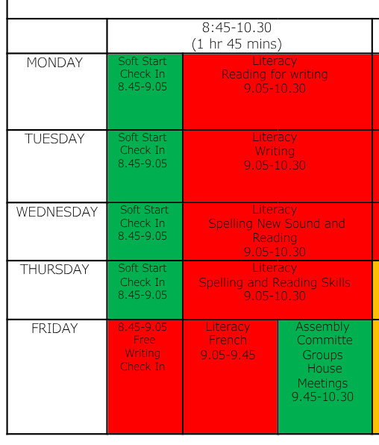
Literacy – Writing and Grammar
How often will writing sessions take place?
Three times a week on Monday, Tuesday and Free Write Friday.
What will writing sessions look like?
-Exploring the text structure of narratives and
other genres.
-Exploring the grammar used in narratives
and other genres (e.g. adjectives and verbs)
-Free writing to build writing stamina and
Personal interest.
How will we work?
Guided teaching, whole class,
group and independent working.

Slide 10
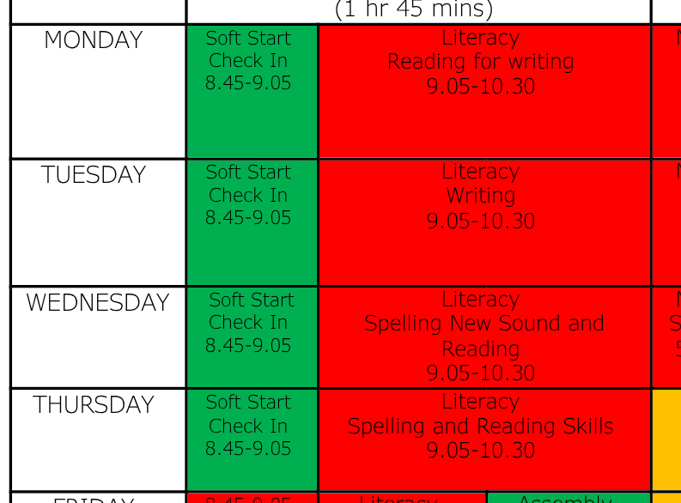
Literacy – Reading and Spelling
How often will reading sessions take place?
Three times a week on Monday, Wednesday and Thursday.
What will reading sessions look like?
-Developing reading skills and comprehension.
-Reading genres linked to our
writing 'Reading for writing'.
-Spelling patterns linked to
reading texts through
'Phonics International'
and writing genres
-Opportunities for free reading.
How will we work?
Guided teaching, whole class,
group and independent working.

Slide 11


Literacy – Listening and Speaking
  Daily opportunities for talking and listening with a partner, in a small group or to the whole class.
  Skills Builder sessions.
  There will also be opportunities across the year to take part in a more formal situation by presenting to the class.

Slide 12


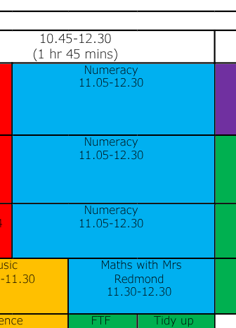
Numeracy and Maths
Numeracy: Place value, addition and subtraction
Maths: Data handling
Mental maths: Number talks
How often will numeracy and maths sessions take place?
Four days a week Mon-Thurs
What will numeracy and maths sessions look like?
-Using concrete, pictorial and abstract
-Digital games and tasks
-Group and partner games
-Oral tasks such as skip counting,
whiteboard tasks and jotter tasks
How will we work?
Guided teaching, whole class,
group and independent working.

Slide 13


Our Health and Wellbeing
UNCRC Focus – Children’s Rights
SOAR Values
Positive relationships – Ready, Respect, Safe
Daily HWB check-ins (zones of regulation)
Class Charter
One Trusted Adult
WL HWB Trackers
RSHP education
https://rshp.scot/

Slide 14
PE
Tuesday with Miss Clark
Thursday with Mrs Redmond
Your child should wear their PE to school on Tuesdays and Thursdays that would be suitable for indoor or outdoor environments.

Slide 15

Homework –
Spelling task
Maths or numeracy task
Reading book pages
Occasional topic tasks
Uploaded on Seesaw
Jotters and log ins will be provided
Homework will start after the September break

Slide 16





Skills
Introduce skills builder – common language, consistency and progression across the school.

Slide 17





Digital Learning
Digital devices for independent, partner and small group tasks are based in the classroom, and are available at all times to support learning.
Class sets are also available for planned whole class activities.
We also use programmable devices such as Bee Bots
Please inform school office if you need help accessing digital devices from home.
Change icons below if needed?

Slide 18
Pupil Voice
Consultative planners for topics
Seesaw to upload and share work and achievements
Committee groups
House Meetings

Slide 19
Important Dates
Parent consultation 1:
Tuesday 14th, Wednesday 15th October
Parent consultation 2:
Tuesday 10th March, Wednesday 11th March
Parent pop in 1:
Thursday 20th November 1.30pm-3.00pm
P3 class assembly:
Friday 28th November 9.45am-10.30am

Slide 20
Thank you!
If you wish to attend a further workshop with another teacher, then please head back to the hall where our P7 helpers will escort you to the correct class.

