Slide 1
Mid Calder Primary School
Primary 1 - Meet the Teacher
Mrs Stevenson
Tuesday 26th August 2025
2 sessions: 6-6:30pm, 6:30-7pm

Slide 2
Structure of the School Day
Monday to Thursday
8.00 Breakfast Club (Optional)
8.30 Playground supervision
8.45 School Day starts
10.30-10:45 Morning Break
12.30-1:10 Lunch
15.05 End of School Day
Friday
As above but…
12:25 End of School Day

Slide 3
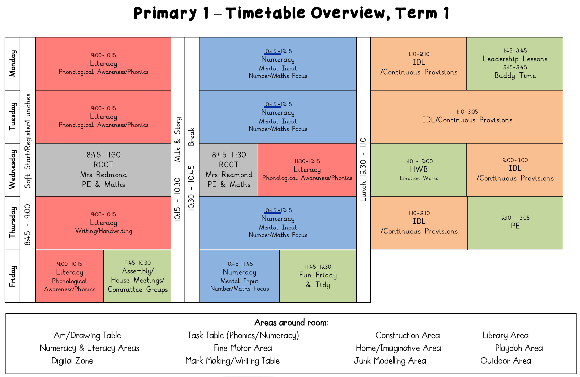
Weekly Timetable

Slide 4
School Uniform
Grey trousers/skirt/shorts and white shirt/blouse and red & grey striped school tie (grey/red cardigan optional)
Grey trousers/skirt/shorts and red school polo shirt with school badge and grey school sweatshirt with school badge
Grey school cardigan
Summer: Red and white gingham dress with red or grey cardigan
P.E. Kit: As we promote physical activity and outdoor learning, we recommend pupils wearing school logo joggers/shorts and jumpers on PE days.
Please also provide wellies, jackets, sunscreens etc. where appropriate – we aim to be outside in all weathers so please ensure your child is equipped for the day and the changing elements!
PLEASE NAME EVERYTHING!
*Nearly New/Used Uniform Available from School Uniform ‘Swap Shop’
Any clothing donations welcome.

Slide 5
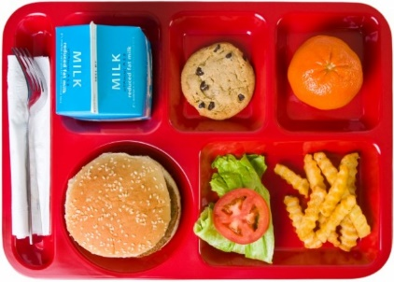
Lunchtime Reminder
School lunches are ordered daily through iPay impact – All P1-5 children are entitled to free school lunch
Please look at the lunches at home with your child and pre order their lunches for the week.
Any problems with accessing iPay please call our School office

Slide 6
Important Documents
Please return the photo permission forms and EE2 forms as soon as possible if you haven’t already done so. We cannot share any photos on the school website or on Seesaw until these are returned.
Please ensure that all medical forms are filled in fully and handed back promptly with any appropriate medication.
We cannot issue medication to children unless the relevant form is completed and boxed/prescription information is shared.
Please update the school office if there are any changes to address, phone number, medication etc. during the year.

Slide 7




Interdisciplinary Learning (IDL)
Across our school we use consultative planning methods which means that our “topic” based learning comes from our pupils.
The focus and content of this learning is determined by questions, investigations and interests from our children – they help to design what they would like to learn.
We then create activities to support and develop this learning, alongside curriculum experiences, outcomes and planned assessments using our national Curriculum For Excellence benchmarks.
This term, our learning context will begin
with Minibeasts

Slide 8
Literacy – Phonics
Children will participate in various activities which will develop their:
  Letter recognition skills
  Letter formation skills
  Decoding & Encoding skills
  Tricky words

Slide 9
Literacy – Reading
Our reading in term 1 will focus on exploring fiction texts, and through a range of picture books and stories, we will learn about different characters and settings.
Children will take part in active reading tasks to develop and consolidate their reading skills
After the September break, your child will begin to bring home books. We use Floppy’s Phonics and Reading Rockets.

Slide 10
Literacy – Reading
Other resources that may be used include:
Snapdragon books - fiction
Fireflies – Non-fiction
Jolly Phonics Readers
Rhyme books
ORT

Slide 11
Literacy – Writing
Our writing will focus on developing detailed black pen drawings and mark making, building on children’s personal experiences and imagination.

Slide 12
Numeracy and Maths
Number will be taught through a variety of active tasks. This will develop skills in:
  Numerals and number structure from 0 to 10 and then beyond – dots, fingers, ten frames, rekenrek
  Forward and backward number word sequences
  Counting in steps of one, two, five & ten
  Formation of numbers
  Addition and subtraction within 10 and beyond
  Sharing

Slide 13
Numeracy and Maths
Beyond Number:
  Sorting and matching
  Pattern
  2D shapes and 3D objects
  Recognising and using coins
  Information handling
  Time - days of week, months of year, seasons, key dates, o’clock

Slide 14


Our Health and Wellbeing
UNCRC Focus – Children’s Rights
SOAR Values
  Successful, Optimistic, Adventurous & Respectful
Positive relationships – Ready, Respect, Safe
Daily HWB check-ins
Class Charter
One Trusted Adult
WL HWB Trackers

Slide 15
Health and Wellbeing
P.E – Wednesday & Thursday
Focus on:
Sharing space
Following instructions
Teamwork
Developing a growth mindset

Slide 16
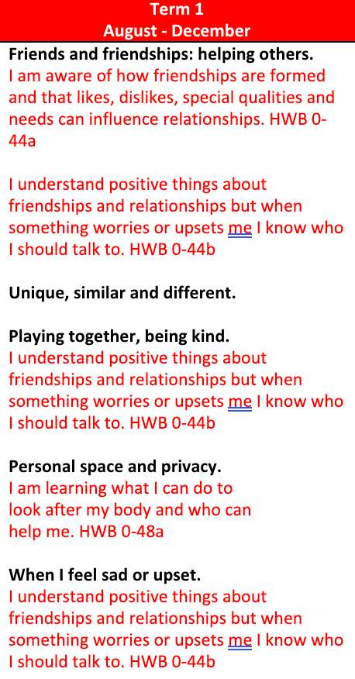
Health and Wellbeing
In school we use programs such as:
Emotion Works
The national resource for relationships, sexual health and parenthood (RSHP) education.
https://rshp.scot/early-level/
Please feel free to visit the site and explore the resources and if you have any questions after looking, don’t hesitate to ask.

Slide 17
Homework
After the September Break
Homework will be given on a Wednesday to be returned on Tuesday.
Reading books and sounds/words will be sent home to be practised whenever possible.
SEESAW – Additional literacy and numeracy tasks will be given in the style of a grid.
Please bring homework folders with reading books, diaries and sound/word tubs to school every day.

Slide 18







Skills
In Mid Calder we use the Skills Builder Programme.
The programme allows us to support every child build essential skills that will not only help them thrive in school but also in their wider lives.
We are currently the only school in Scotland that has Silver award accreditation and waiting for our Gold accreditation.

Slide 19
Pupil Voice
As mentioned previously, the children are at the heart of all our planning. With the focus and content of our topics being determined by questions, investigations and interests from the children.
This year we will also be setting up - Committee groups for P1-P3 and P4-P7.
  These will cover Skills, Eco/Sustainability,, Pupil Parliament, Rights
House Meetings

Slide 20





Digital Learning
Digital devices for independent, partner and small group tasks are based in the classroom, these are always available to support learning.
Class sets are also available for planned whole class activities.
Please inform school office if you need help accessing digital devices from home.

Slide 21
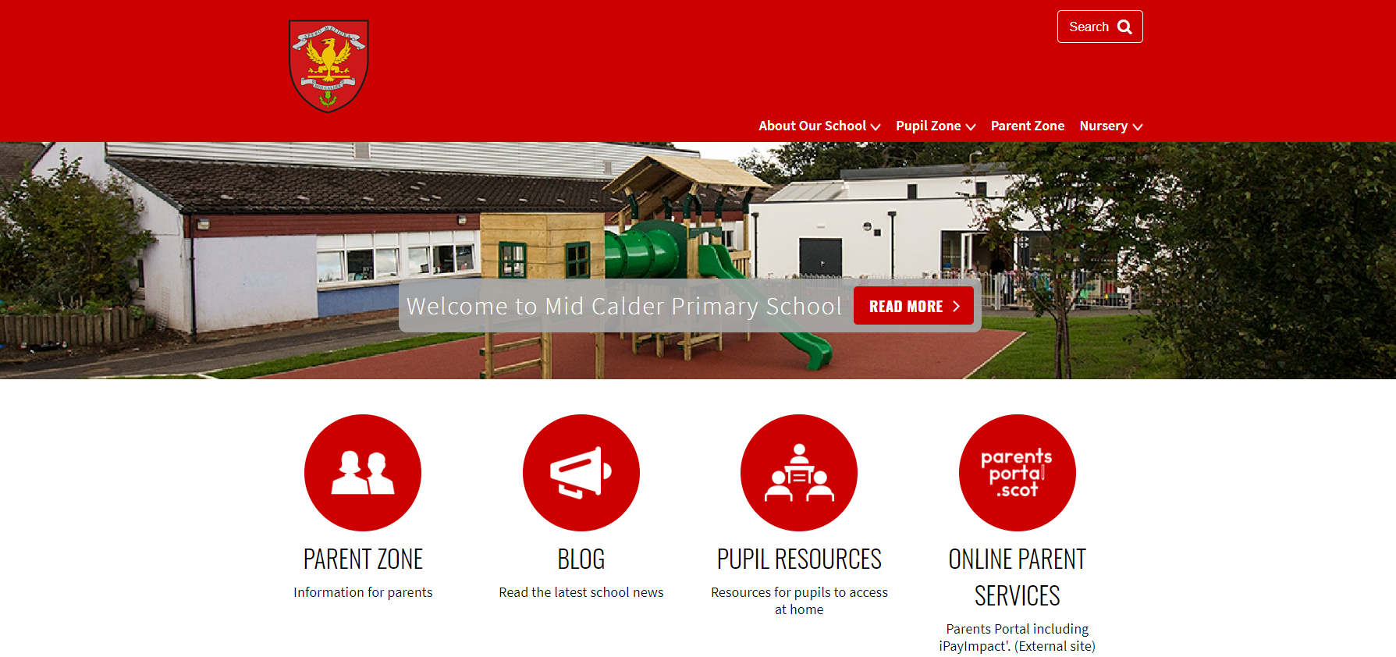
Website: https://midcalderprimary.westlothian.org.uk/

Slide 22


Slide 23
Thank you!
Thank you for coming this evening, it’s lovely to see you all!
If you wish to attend a further workshop with another teacher, then please head back to the hall where our P7 helpers will escort you to the correct class.
Please don’t hesitate to get in touch if you have any questions or queries throughout the year.

